Slide 1
Higher Education Committee 2025-2026
Annual Work and Impact Presentation

Slide 2
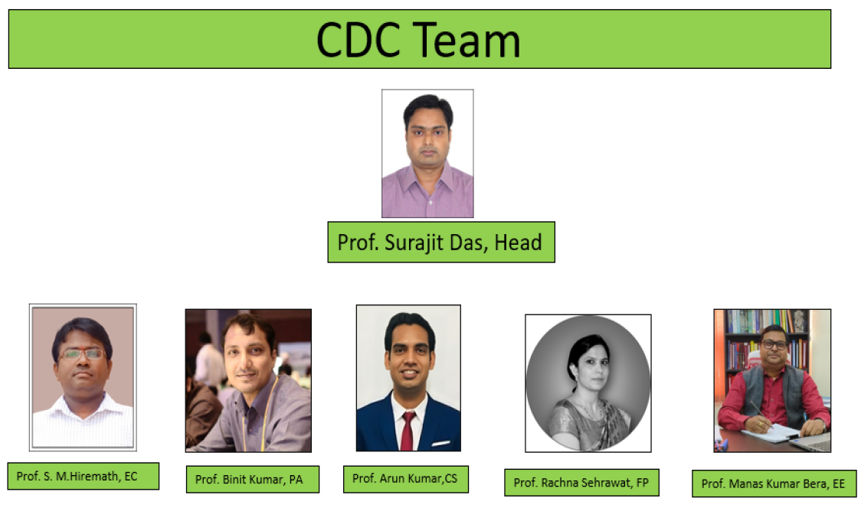

Slide 3
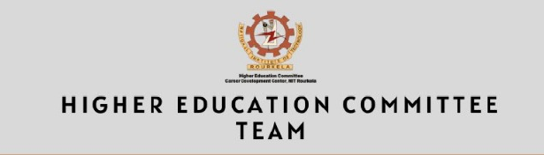
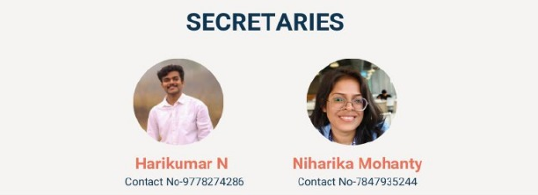

Slide 4
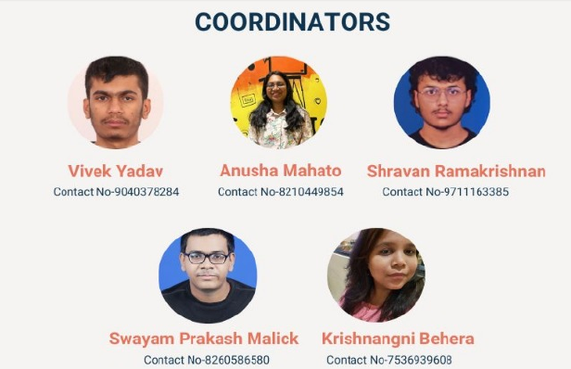

Slide 5
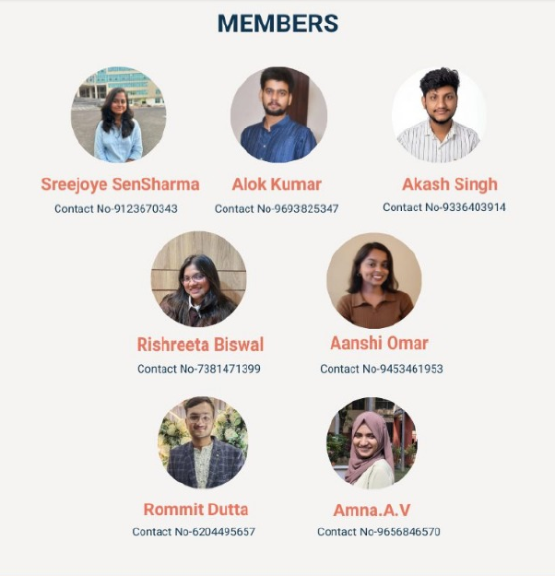

Slide 6
Activities Conducted
1) Interactive Session on Career Pathways and Research Opportunities in Networking & Security
Date & Time: 21st August 2025, 5:00 PM – 7:30 PM
Speaker: Dr. Ashutosh Dutta – Senior Scientist and Professor, Johns Hopkins University (and recognized expert in 5G/6G, networking, and security domains)
Highlights:
● Shared insights on the evolution of 5G/6G technologies and their research challenges.
● Gave career guidance for students aspiring for research and higher education abroad.
● Addressed questions on industry-academia collaborations, internships, and skill building.

Slide 7
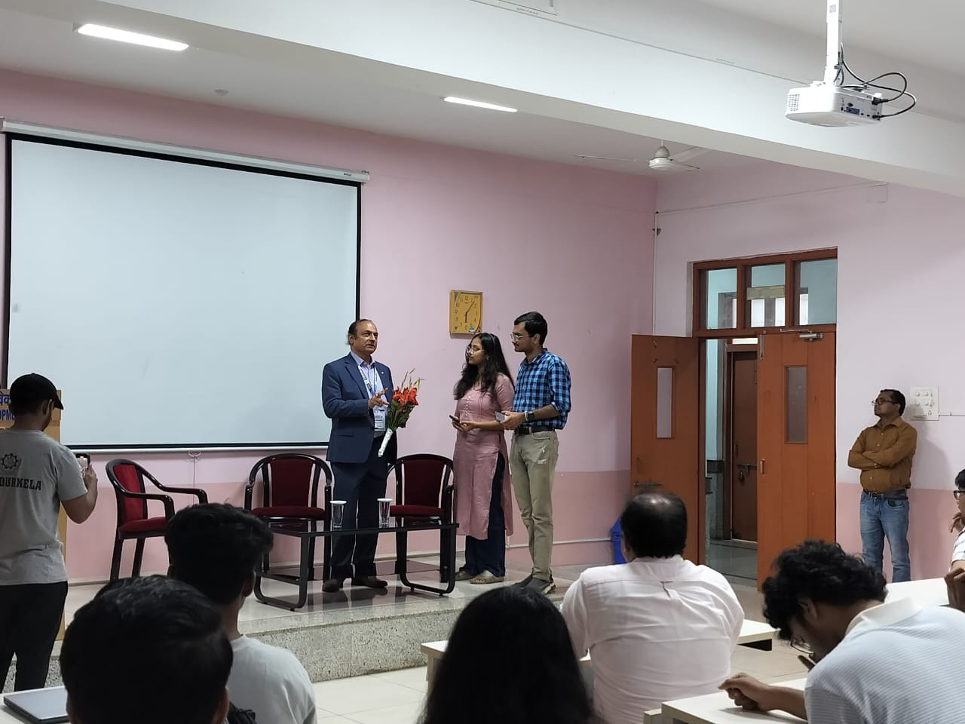

Slide 8
2) Internship Series 2025:From Lecture Halls to Global Labs
Date and Time: 3rd September 2025 (Wednesday), 6:00 PM in the PPT Room, TIIR Building.
Speakers: Param Joshi, Int. MSc Physics, Summer Research Student at ASTRON, Netherlands, with prior experiences at Oxford University, PRL, IIT Bombay, and the SETI Institute (USA).
Abhipsa Dash, B.Tech Biomedical Engineering, Research Intern at Iowa State University, USA (REU-TRACE Program), and AIR 36 in GATE 2025.
Sachin Mishra, B.Tech Biomedical Engineering, Research Intern at Ming Chi University of Technology, Taiwan
The session aimed to guide students aspiring for foreign research internships by providing insights into preparation strategies, prerequisites, resume building, SOP and LOR writing, cold mailing techniques, and the selection process.

Slide 9
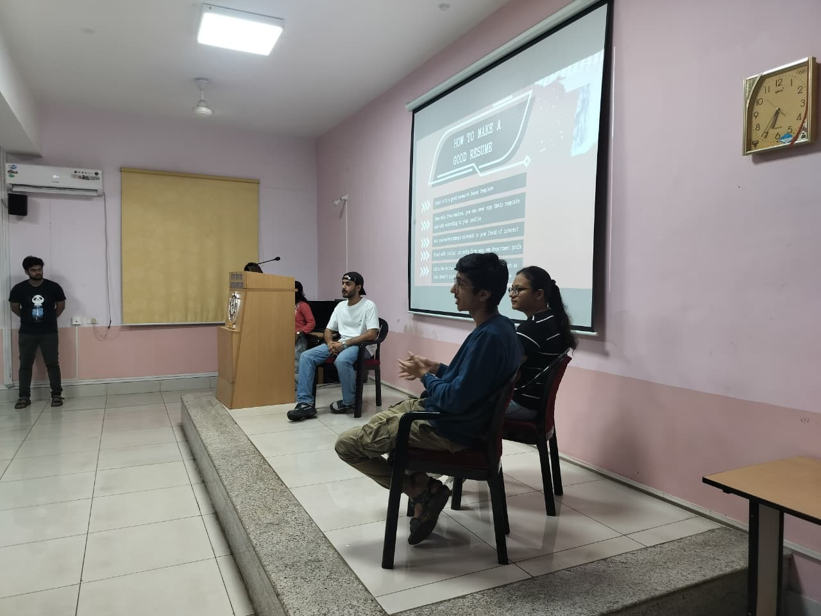
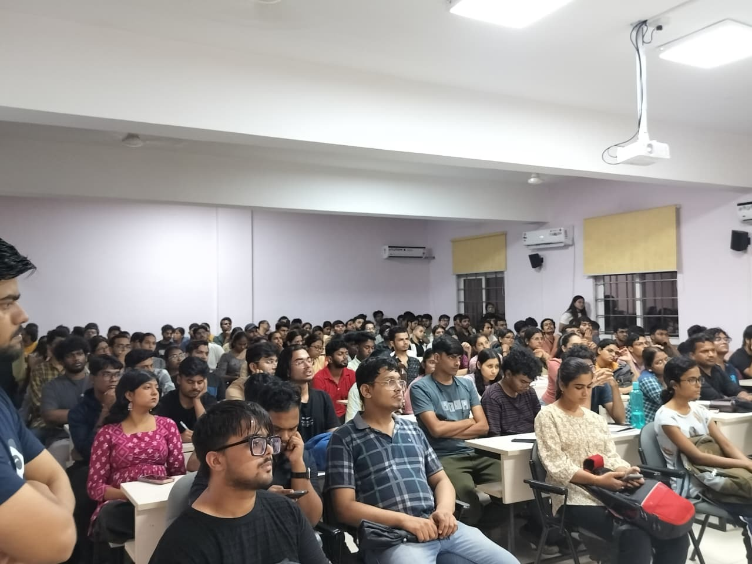

Slide 10
3) Seminar on Overseas Educational Options & Job Opportunities Abroad by IDP Bhubaneswar
Date: 14th October
Time: 10am
Venue: TIIR Auditorium
Key Focus Areas:
Overview of study abroad programs and top-ranked universities
Information on funding opportunities and scholarships
Guidance on application processes
Insights into career and research opportunities post-graduation
IELTS preparation tips and resources

Slide 11
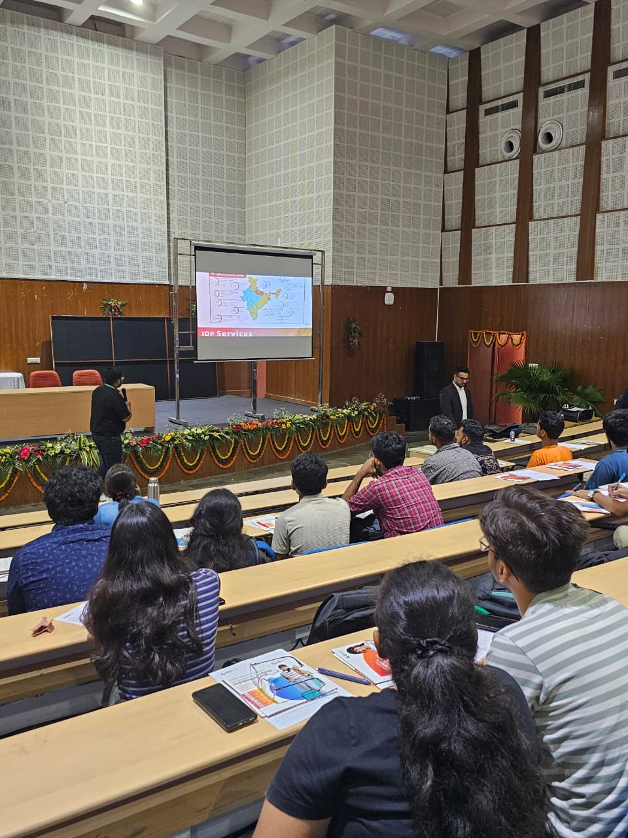
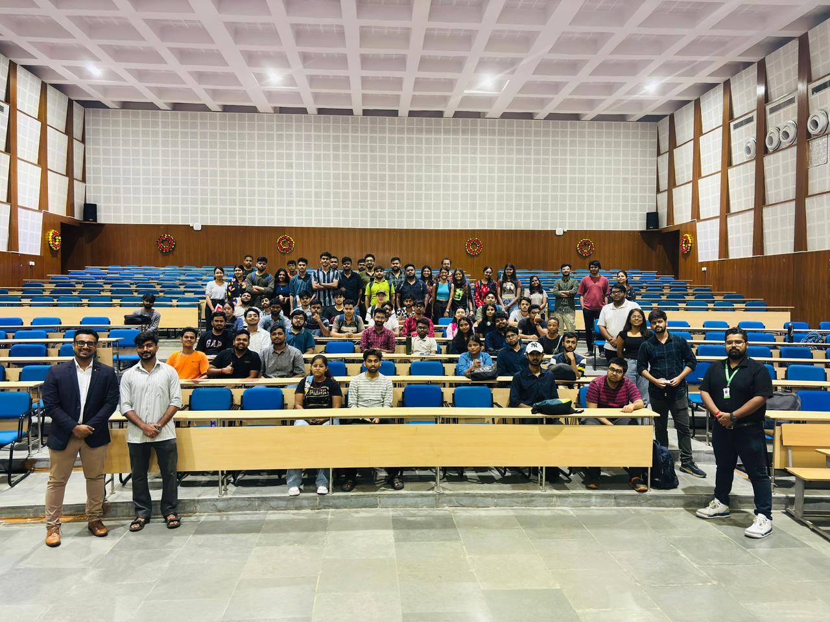

Slide 12
4) CAT Unlocked By ABHISHEK AGARWAL
Speaker : Abhisek Agarwal NIT Rourkela ‘22 IIM Calcutta PGP ‘26
Date & Time: 25 Oct, Sat | 4:00 PM Platform: Google Meet
Topics Discussed
Importance of CAT (Gateway to IIMs, wide acceptance, career impact)
Exam Overview (Mode, duration, sections, marking scheme)
Section-wise syllabus (VARC, DILR, QA key topics)

Slide 13
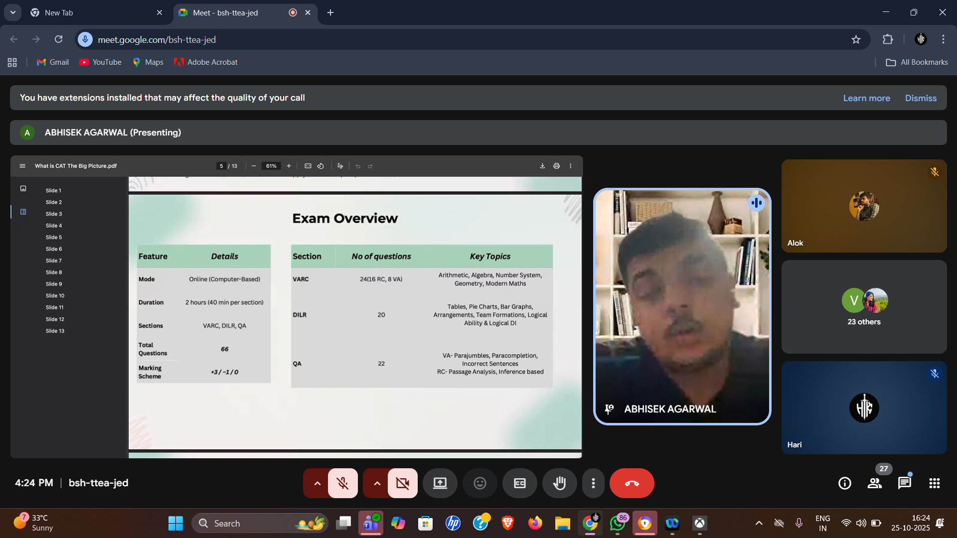

Slide 14
5) FROM NIT TO GLOBAL CAREER – THE EXACT STUDY ABROAD ROADMAP : LEAPSCHOLAR
Date: 12th March 2026
Time: 6:00 PM – 7:00 PM
Session was for the students to:
Find out if studying abroad is financially worth it.
Get a personalized country & course shortlist based on their profile
Discover realistic scholarships they actually qualify for
Learn how to avoid common visa rejection mistakes
Understand job opportunities, visa & PR pathways after graduation

Slide 15
Guidance Documents/ Resources shared with the Students through our Whatsapp Community consisting of 3000+ students
1.Newsletters
2.Document: Building a Strong Research CV
3.Google sheets containing details about 1584 IIT Professors.
4.Connecting with Seniors Abroad and Accessing Mentorship for PhD Opportunities.
5.Updating students about various Higher Education and Research Internship programmes through the WhatsApp community in a clear and concise manner for their convenience.

Slide 16
Newsletters
Two newsletters consisting of:
An overview of four major standardized tests—GRE, GMAT, TOEFL, and IELTS—covering their purpose, exam format, approximate costs, probable test dates, and leading global universities that accept these scores.
An overview of postgraduate opportunities in India and abroad, including details on degrees such as M.Tech, MS, MBA, MIM, PhD, and more. It also covers the required exams, career prospects, and leading universities for each path.

Slide 17
Building a Strong Research CV
The document consisted about all the below mentioned points in details.
Importance of a well-structured and professional academic CV
How to effectively present education and research experience
Emphasis on clarity, brevity, and impact
Showcasing technical skills, tools, and research contributions
Including publications, achievements, and academic activities
Keeping the CV concise, keyword-optimized, and error-free

Slide 18
Google sheets containing details about 1584 IIT Professors
This document consisted of a compiled list of faculty members from the various departments along with their respective research areas and contact details. It will serve as a reference for students to identify professors based on specific research interests,facilitating academic outreach and collaboration opportunities.

Slide 19
Connecting with Seniors Abroad and Accessing Mentorship for PhD Opportunities.
This document consisted of :
Answers to some general questions raised by the students.
List of members of HEC with contact details
Contact information of a few trusted partner agencies

Slide 20
Updating students about various Higher Education and Research Internship programmes through the WhatsApp community in a clear and concise manner for their convenience.
Shared around 90+ Higher Education and Internship opportunities among the students both for the winter break 2025 and summer 2026.

Slide 21

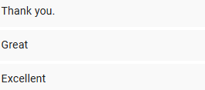
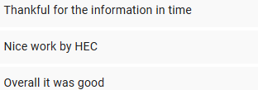

FEEDBACK RECEIVED FROM THE STUDENTS THIS YEAR.

Slide 22
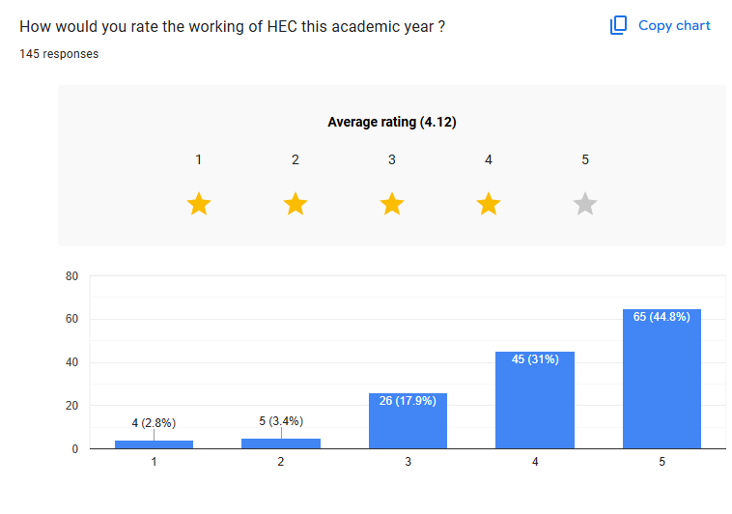
How would you rate the working of HEC this academic year ? 145 responses

Slide 23
Suggestions received from the students that can be considered next year
Emphasis on how to prepare applications for foreign research internships at the very start of the semester.
Would prefer to see more international internship opportunities such as SURF programs, SURI from ASU and RISC from UMD for example. Possibly a separate group specifically for it wherein all these opportunities are consolidated in one place.
I just felt this time, update for a lot of internship details was at the last hour,, rest it was cool !

Slide 24
Thankyou

